Slide 1
Data Structures and algorithms QUEUE DATA STRUCTURE

Slide 2
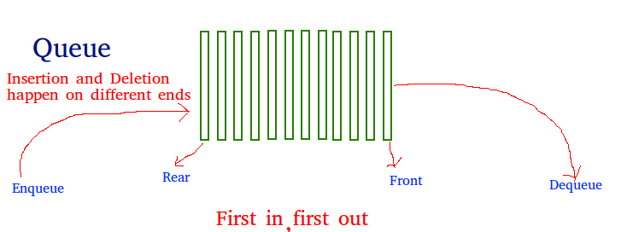
Queue – DATA STRUCTURE
The queue is a basic data structure just like a stack. In contrast to stack that uses the LIFO approach, queue uses the FIFO (first in, first out) approach. With this approach, the first item that is added to the queue is the first item to be removed from the queue. Just like Stack. the queue is also a linear data structure.

Slide 3
Queue – DATA STRUCTURE
In a real-world analogy, we can imagine a bus queue where the passengers wait for the bus in a queue or a line. The first passenger in the line enters the bus first as that passenger happens to be the one who had come first.
A queue is a useful data structure in programming. It is similar to the ticket queue outside a cinema hall, where the first person entering the queue is the first person who gets the ticket.
Queue follows the First In First Out(FIFO) rule - the item that goes in first is the item that comes out first too.

Slide 4
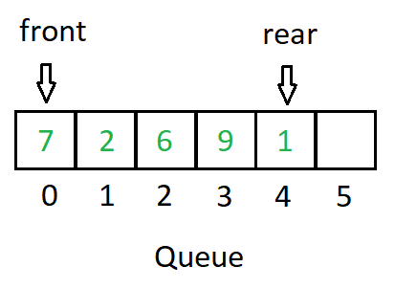
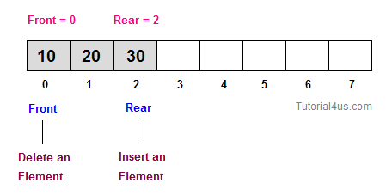
Queue – DATA STRUCTURE

Slide 5
Queue – DATA STRUCTURE
A queue is an object or more specifically an abstract data structure(ADT) that allows the following operations:
Enqueue: Add an element to the end of the queue
Dequeue: Remove an element from the front of the queue
IsEmpty: Check if the queue is empty
IsFull: Check if the queue is full
Peek: Get the value of the front of the queue without removing it

Slide 6
Queue – DATA STRUCTURE
How Queue Works?
Queue operations work as follows:
Two pointers called FRONT and REAR are used to keep track of the first and last elements in the queue.
When initializing the queue, we set the value of FRONT and REAR to -1.
On enqueuing an element, we increase the value of REAR index and place the new element in the position pointed to by REAR.
On dequeuing an element, we return the value pointed to by FRONT and increase the FRONT index.

Slide 7
Queue – DATA STRUCTURE
How Queue Works?
Before enqueuing, we check if the queue is already full.
Before dequeuing, we check if the queue is already empty.
When enqueuing the first element, we set the value of FRONT to 0.
When dequeuing the last element, we reset the values of FRONT and REAR to -1.

Slide 8
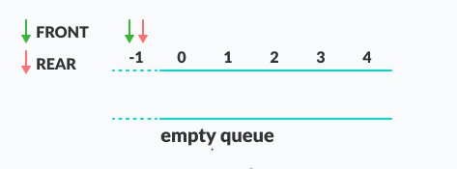
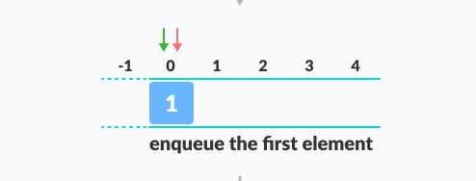
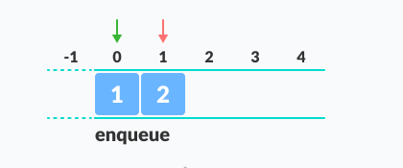
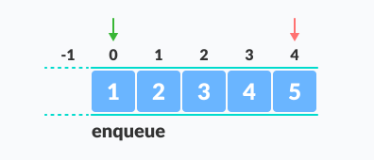
Queue – DATA STRUCTURE

Slide 9
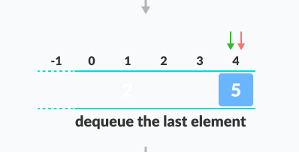
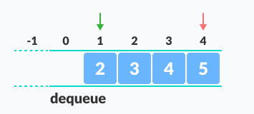
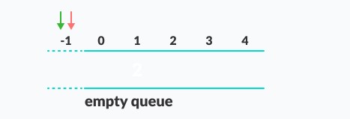
Queue – DATA STRUCTURE

Slide 10
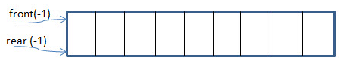
Queue – DATA STRUCTURE
Queue In C++
We have two ends i.e. “front” and “rear” of the queue. When the queue is empty, then both the pointers are set to -1.
The “rear” end pointer is the place from where the elements are inserted in the queue. The operation of adding /inserting elements in the queue is called “enqueue”.
The “front” end pointer is the place from where the elements are removed from the queue. The operation to remove/delete elements from the queue is called “dequeue”.

Slide 11
Queue – DATA STRUCTURE
We have two ends i.e. “front” and “rear” of the queue. When the queue is empty, then both the pointers are set to -1.
The “rear” end pointer is the place from where the elements are inserted in the queue. The operation of adding /inserting elements in the queue is called “enqueue”.
The “front” end pointer is the place from where the elements are removed from the queue. The operation to remove/delete elements from the queue is called “dequeue”.
When the rear pointer value is size-1, then we say that the queue is full. When the front is null, then the queue is empty.

Slide 12
Queue – DATA STRUCTURE
Enqueue
In this process, the following steps are performed:
Check if the queue is full.
If full, produce overflow error and exit.
Else, increment ‘rear’.
Add an element to the location pointed by ‘rear’.
Return success.

Slide 13
Queue – DATA STRUCTURE
Dequeue
Dequeue operation consists of the following steps:
Check if the queue is empty.
If empty, display an underflow error and exit.
Else, the access element is pointed out by ‘front’.
Increment the ‘front’ to point to the next accessible data.
Return success.

Slide 14
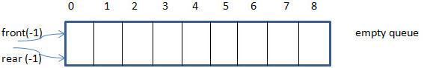
Queue – DATA STRUCTURE
This is an empty queue and thus we have rear and empty set to -1.
Next, we add 1 to the queue and as a result, the rear pointer moves ahead by one location.

Slide 15
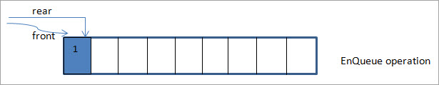
Queue – DATA STRUCTURE
In the next figure, we add element 2 to the queue by moving the rear pointer ahead by another increment.

Slide 16
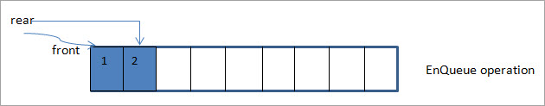
Queue – DATA STRUCTURE
In the next figure, we add element 2 to the queue by moving the rear pointer ahead by another increment.

Slide 17
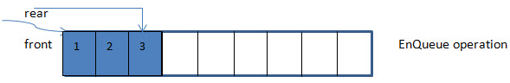
Queue – DATA STRUCTURE
At this point, the rear pointer has value 2 while the front pointer is at the 0th location.
Next, we delete the element pointed by the front pointer. As the front pointer is at 0, the element that is deleted is 1.

Slide 18
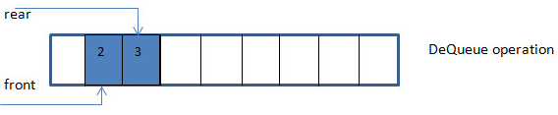
Queue – DATA STRUCTURE
Thus the first element entered in the queue i.e. 1 happens to be the first element removed from the queue. As a result, after the first dequeue, the front pointer now will be moved ahead t0 the next location which is 1.

Slide 19
Queue – DATA STRUCTURE
C++ Implementation
#include <iostream>
#define MAX_SIZE 5
using namespace std;
class Queue {
private:
int myqueue[MAX_SIZE], front, rear;
public:
Queue() {
front = -1;
rear = -1;
}

Slide 20
Queue – DATA STRUCTURE
bool isFull() {
if (front == 0 && rear == MAX_SIZE - 1) {
return true;
}
return false;
}
bool isEmpty() {
if (front == -1) return true;
else return false;
}

Slide 21
Queue – DATA STRUCTURE
void enQueue(int value) {
if (isFull()) {
cout << endl << "Queue is full!!";
}
else {
if (front == -1) front = 0;
rear++;
myqueue[rear] = value;
cout << value << " ";
}
}

Slide 22
Queue – DATA STRUCTURE
void displayQueue()
{
int i;
if (isEmpty()) {
cout << endl << "Queue is Empty!!" << endl;
}
else {
cout << endl << "Front = " << front;
cout << endl << "Queue elements : ";
for (i = front; i <= rear; i++)
cout << myqueue[i] << "\t";
cout << endl << "Rear = " << rear << endl;
}
}

Slide 23
Queue – DATA STRUCTURE
int deQueue() {
int value;
if (isEmpty()) {
cout << "Queue is empty!!" << endl; return(-1);
}
else {
value = myqueue[front]; if (front >= rear) { //only one element in queue
front = -1;
rear = -1;
}
else {
front++;
}
cout << endl << "Deleted => " << value << " from myqueue";
return(value);
}
}

Slide 24
TYPES OF QUEUES IN DATA STRUCTURE

Slide 25

Queue – DATA STRUCTURE
Simple Queue
In a simple queue, insertion takes place at the rear and removal occurs at the front. It strictly follows FIFO rule.

Slide 26
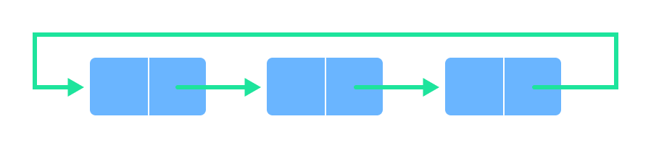
Queue – DATA STRUCTURE
Circular Queue
In a circular queue, the last element points to the first element making a circular link.
The main advantage of a circular queue over a simple queue is better memory utilization. If the last position is full and the first position is empty then, an element can be inserted in the first position. This action is not possible in a simple queue.

Slide 27
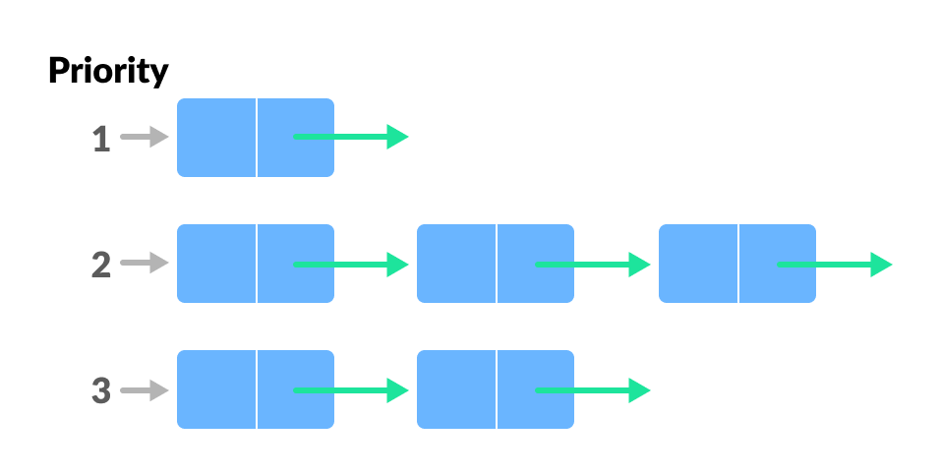
Queue – DATA STRUCTURE
Priority Queue
A priority queue is a special type of queue in which each element is associated with a priority and is served according to its priority. If elements with the same priority occur, they are served according to their order in the queue.
Insertion occurs based on the arrival of the values and removal occurs based on priority.

Slide 28
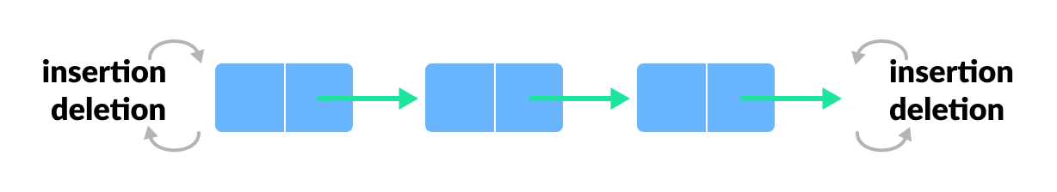
Queue – DATA STRUCTURE
Double Ended Queue
Double Ended Queue is a type of queue in which insertion and removal of elements can be performed from either from the front or rear. Thus, it does not follow FIFO rule (First In First Out).

Slide 29
CIRCULAR QUEUE

Slide 30
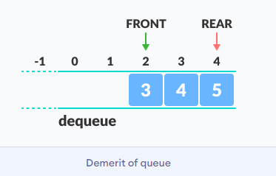
CIRCULAR Queue – DATA STRUCTURE
Circular queue avoids the wastage of space in a regular queue implementation using arrays.
As you can see in the above image, after a bit of enqueuing and dequeuing, the size of the queue has been reduced.
The indexes 0 and 1 can only be used after the queue is reset when all the elements have been dequeued.

Slide 31
CIRCULAR Queue – DATA STRUCTURE
How Circular Queue Works?
Circular Queue works by the process of circular increment i.e. when we try to increment any variable and we reach the end of the queue, we start from the beginning of the queue by modulo division with the queue size.

Slide 32
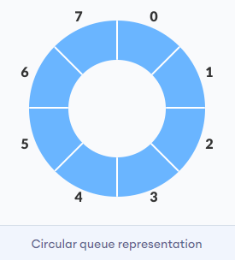
CIRCULAR Queue – DATA STRUCTURE
Queue operations work as follows:
Two pointers called FRONT and REAR are used to keep track of the first and last elements in the queue.
When initializing the queue, we set the value of FRONT and REAR to -1.
On enqueuing an element, we circularly increase the value of REAR index and place the new element in the position pointed to by REAR.

Slide 33
CIRCULAR Queue – DATA STRUCTURE
On dequeuing an element, we return the value pointed to by FRONT and circularly increase the FRONT index.
Before enqueuing, we check if the queue is already full.
Before dequeuing, we check if the queue is already empty.
When enqueuing the first element, we set the value of FRONT to 0.
When dequeuing the last element, we reset the values of FRONT and REAR to -1.

Slide 34
CIRCULAR Queue – DATA STRUCTURE
However, the check for full queue has a new additional case:
Case 1: FRONT = 0 && REAR == SIZE - 1
Case 2: FRONT = REAR + 1
The second case happens when REAR starts from 0 due to circular increment and when its value is just 1 less than FRONT, the queue is full.

Slide 35
CIRCULAR Queue – DATA STRUCTURE
Circular Queue Complexity
The complexity of the enqueue and dequeue operations of a circular queue is O(1) for (array implementations).
Circular Queue Applications
CPU scheduling
Memory management
Traffic Management

Slide 36
PRIORITY QUEUE

Slide 37
PRIORITY Queue – DATA STRUCTURE
A priority queue is a special type of queue in which each element is associated with a priority and is served according to its priority. If elements with the same priority occur, they are served according to their order in the queue.
Generally, the value of the element itself is considered for assigning the priority.
For example: The element with the highest value is considered as the highest priority element. However, in other cases, we can assume the element with the lowest value as the highest priority element. In other cases, we can set priorities according to our needs.

Slide 38
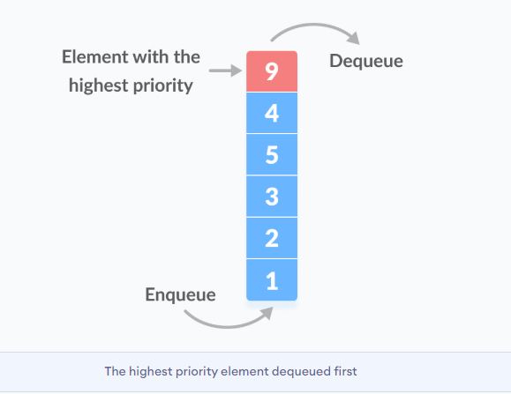
PRIORITY Queue – DATA STRUCTURE

Slide 39
PRIORITY Queue – DATA STRUCTURE
How does priority queue differ from a queue?
In a queue, the first-in-first-out rule is implemented whereas, in a priority queue, the values are removed on the basis of priority. The element with the highest priority is removed first.
Implementation of Priority Queue
Priority queue can be implemented using an array, a linked list, a heap data structure or a binary search tree. Among these data structures, heap data structure provides an efficient implementation of priority queues.

Slide 40
PRIORITY Queue – DATA STRUCTURE
Priority Queue Operations
Basic operations of a priority queue are inserting, removing and peeking elements.
Priority Queue Applications
Some of the applications of a priority queue are:
Dijkstra's algorithm
for implementing stack
for load balancing and interrupt handling in an operating system
for data compression in Huffman code

Slide 41
DOUBLE ENDED QUEUE

Slide 42
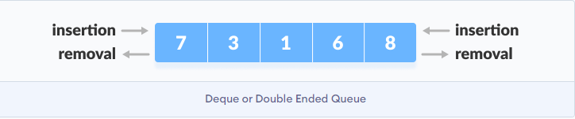
DOUBLE ENDED Queue – DATA STRUCTURE
Deque or Double Ended Queue is a type of queue in which insertion and removal of elements can be performed from either from the front or rear. Thus, it does not follow FIFO rule (First In First Out).

Slide 43
DOUBLE ENDED Queue – DATA STRUCTURE
Types of Deque
Input Restricted Deque
In this deque, input is restricted at a single end but allows deletion at both the ends.
Output Restricted Deque
In this deque, output is restricted at a single end but allows insertion at both the ends.

Slide 44
DOUBLE ENDED Queue – DATA STRUCTURE
Operations on a Double Ended Queue
In a circular array, if the array is full, we start from the beginning.
But in a linear array implementation, if the array is full, no more elements can be inserted. In each of the operations below, if the array is full, "overflow message" is thrown.
Before performing the following operations, these steps are followed.
Take an array of size n.
Set two pointers at the first position and set front = -1 and rear = 0.

Slide 45
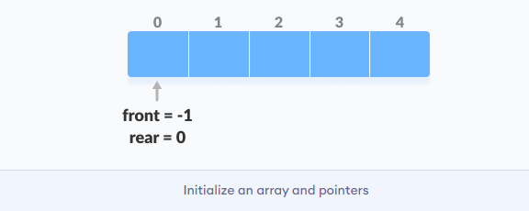
DOUBLE ENDED Queue – DATA STRUCTURE

Slide 46

DOUBLE ENDED Queue – DATA STRUCTURE
Insert at the Front
This operation adds an element at the front.
Check the position of front.

Slide 47
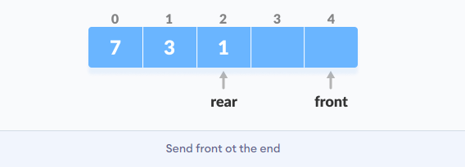
DOUBLE ENDED Queue – DATA STRUCTURE
If front < 1, reinitialize front = n-1 (last index).

Slide 48
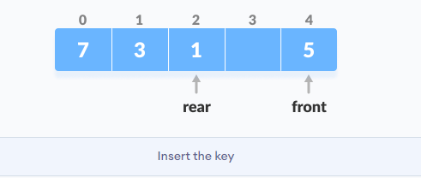
DOUBLE ENDED Queue – DATA STRUCTURE
Else, decrease front by 1.
Add the new key 5 into array[front].

Slide 49
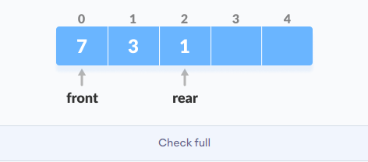
DOUBLE ENDED Queue – DATA STRUCTURE
Insert at the Rear
This operation adds an element to the rear.
Check if the array is full.

Slide 50
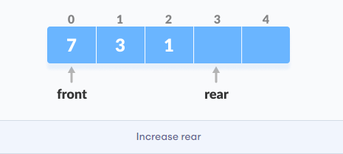
DOUBLE ENDED Queue – DATA STRUCTURE
If the array is full, reinitialize rear = 0.
Else, increase rear by 1.

Slide 51
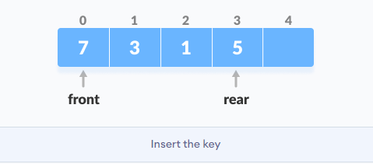
DOUBLE ENDED Queue – DATA STRUCTURE
Add the new key 5 into array[rear].

Slide 52
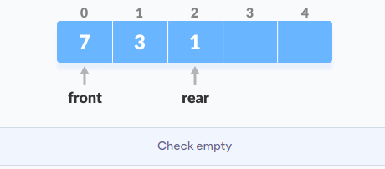
DOUBLE ENDED Queue – DATA STRUCTURE
Delete from the Front
The operation deletes an element from the front.
Check if the array is empty.

Slide 53
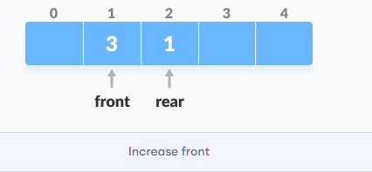
DOUBLE ENDED Queue – DATA STRUCTURE
If the array is empty (i.e. front = -1), deletion cannot be performed (underflow condition).
If deque has only one element (i.e. front = rear), set front = -1 and rear = -1.
Else if front is at the end (i.e. front = n - 1), set go to the front front = 0.
Else, front = front + 1.

Slide 54
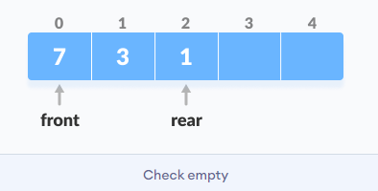
DOUBLE ENDED Queue – DATA STRUCTURE
Delete from the Rear
This operation deletes an element from the rear.
Check if the array is empty.

Slide 55
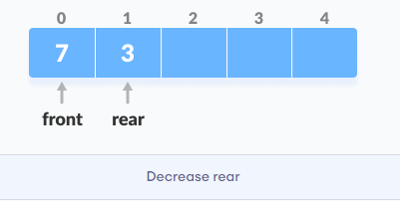
DOUBLE ENDED Queue – DATA STRUCTURE
If the array is empty (i.e. front = -1), deletion cannot be performed (underflow condition).
If deque has only one element (i.e. front = rear), set front = -1 and rear = -1, else follow the steps below.
If rear is at the front (i.e. rear = 0), set go to the front rear = n - 1.
Else, rear = rear - 1.

Slide 56
DOUBLE ENDED Queue – DATA STRUCTURE
Check Empty
This operation checks if the array is empty. If front = -1, the deque is empty.
Check Full
This operation checks if the deque is full. If front = 0 and rear = n - 1, the deque is full.
Double Ended Queue Complexities
The time complexity of all the above operations is constant i.e. O(1).

Slide 57
DOUBLE ENDED Queue – DATA STRUCTURE
Double Ended Queue Applications
In undo operations on softwares.
To store history in browsers.
For implementing both stacks and queues.

